Slide 1

Discovering Consumer Patterns: A Market Basket Analysis Project

Slide 2
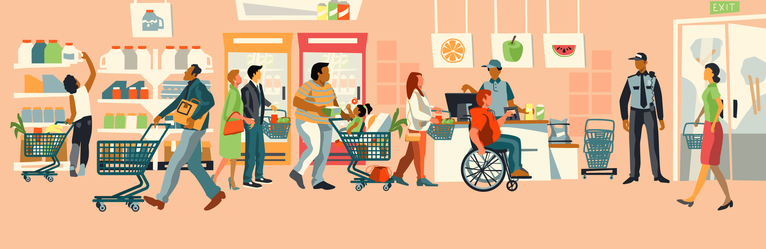

What is Market Basket Analysis?​ Market Basket Analysis is a data analysis technique used to discover relationships between products or items by identifying which items are frequently bought or consumed together. ​ ​ It's primarily used by retailers to optimize product placements, design promotions, and enhance the shopping experience by understanding the purchasing patterns of customers.​

Slide 3
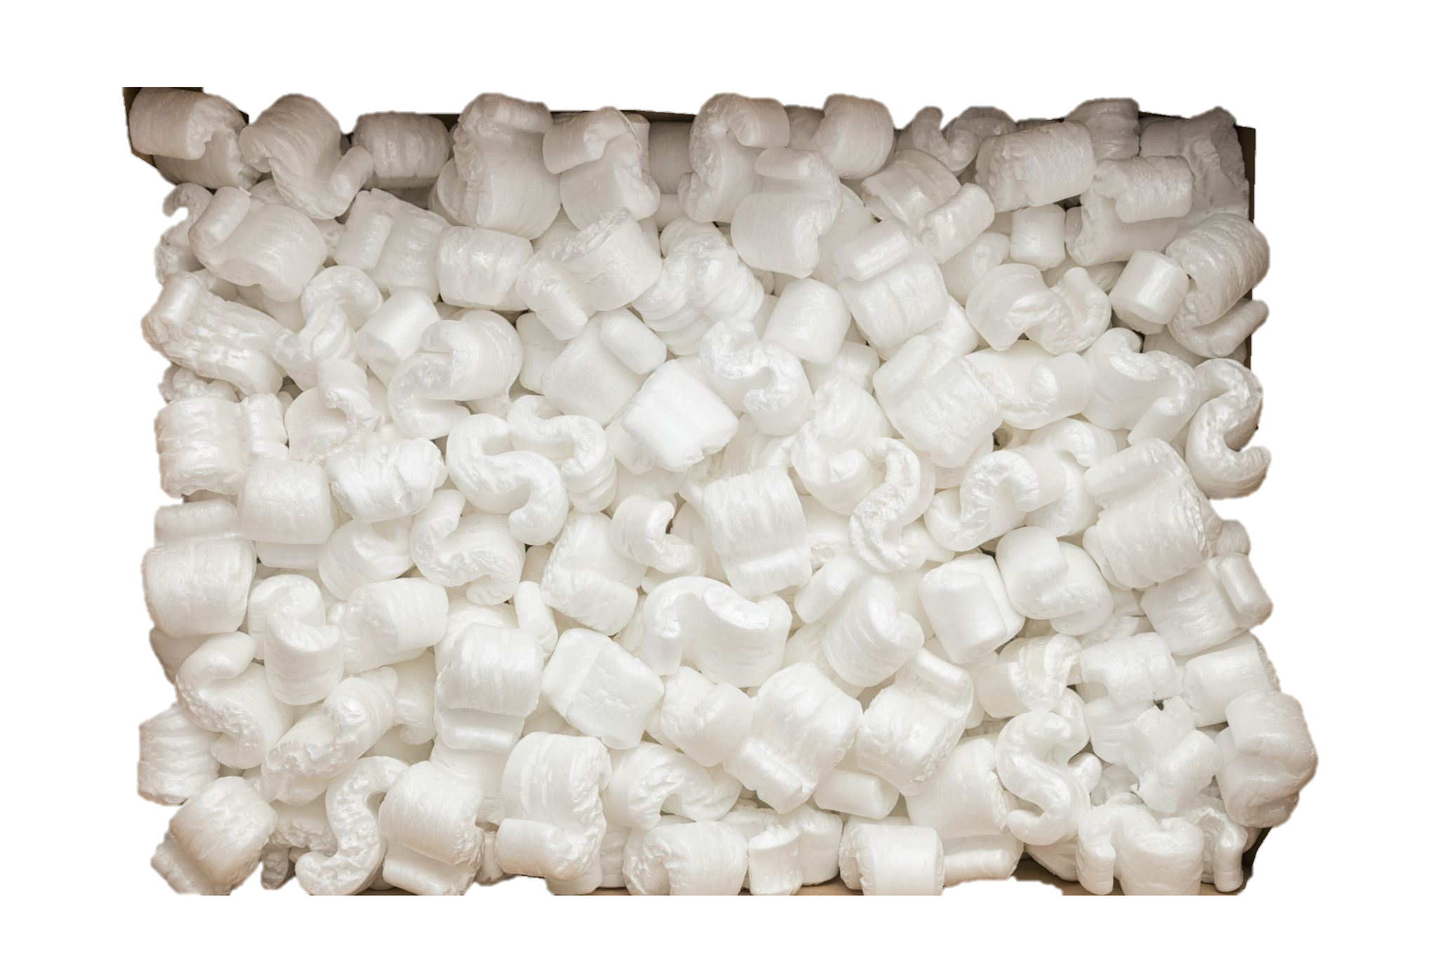

Have you ever heard of beer and diaper story?

Slide 4

What is Association Rule?​ ​ Association rules are IF-THEN statements that reveal connections between items. For example, IF a customer buys Phone (antecedent), THEN they are likely to buy Phone Case (consequent).​

Slide 5
What is Support?​ Support is a fundamental metric in market basket analysis, which is used to measure the frequency of an itemset in the dataset.​

Slide 6
What is Confidence? Confidence is a key metric in market basket analysis which is used to evaluate the reliability of an association rule.

Slide 7
What is Lift?​ Lift in market basket analysis, measures the strength of an association between A and B, considering their co-occurrence in transaction data.​ If X -> Y > 1 more likely a positive relation​ If X -> Y = 1 X and Y are independence​ If X -> Y < 1 more likely a negative relation

Slide 8

An Example of Association Rules: Assume there are 100 customers, 10 of them bought milk, 8 bought butter and 6 bought both. bought milk => bought butter support = P(Milk & Butter) = 6/100 = 0.06 confidence = support/P(Butter) = 0.06/0.08 = 0.75 lift = confidence/P(Milk) = 0.75/0.10 = 7.5

Slide 9
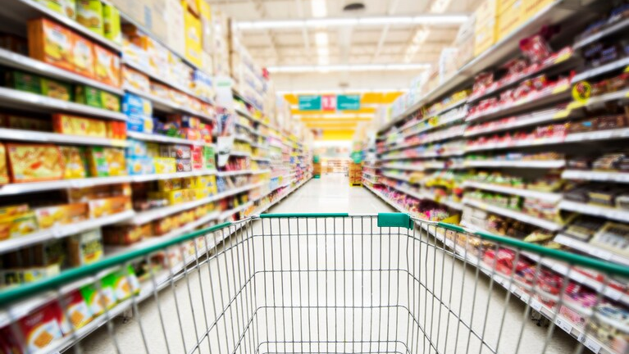
What are the types of Market Basket Analysis?​ Frequent Itemset and Association Rule Mining: Discover itemset that frequently appear together in transactions and establish rules that predict the co-occurrence of items.​ Sequential Pattern Mining: Analyze sequences in which items are purchased, helping to predict the next purchase based on a sequence of previous purchases.​ Segmentation-based MBA (Clustering): Group similar items or customers based on purchasing behavior or item attributes.​ ​

Slide 10
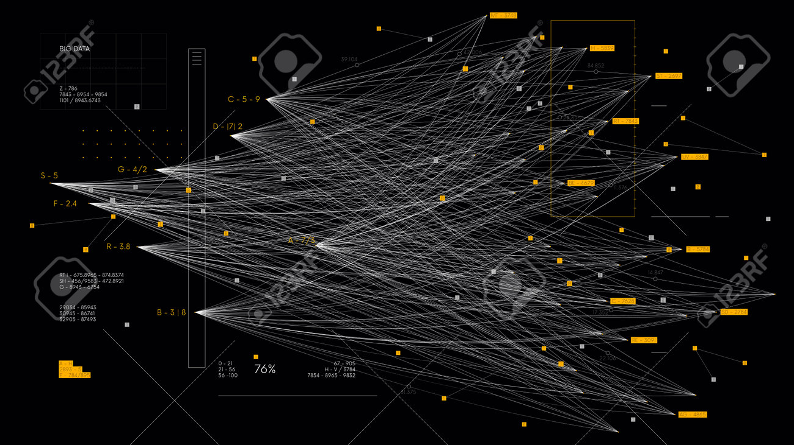
WHAT ARE THE ALGORITHMS IN MARKET BASKET ANALYSIS?​ Apriori Algorithm AIS Algorithm SETM Algorithm FP Growth ​

Slide 11
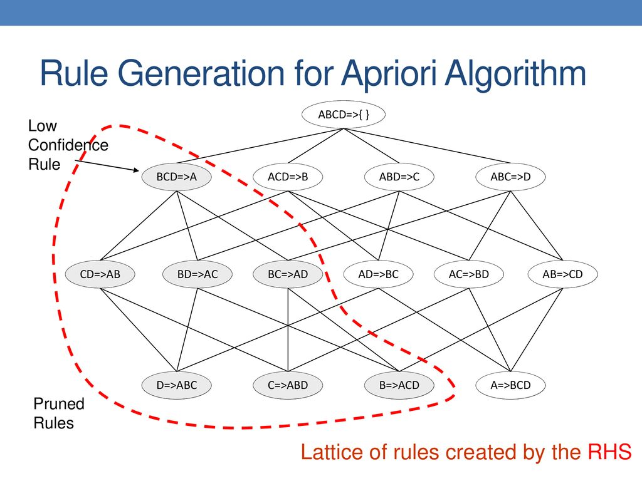
What is Apriori Methodology?​ - A method for finding frequent item-sets in transactional data, based on the principle that a subset of a frequent itemset is also frequent.​ ​ Examples:​ 1. Finding Love with Apriori Methodology. ​ 2. e-commerce, to recommend products.

Slide 12
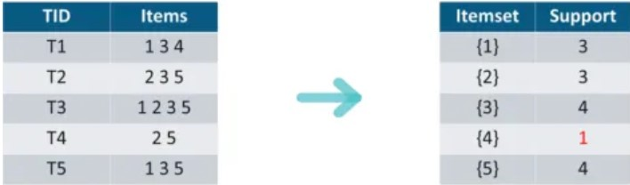
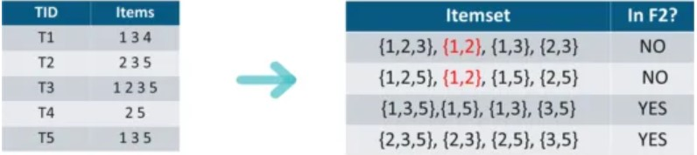

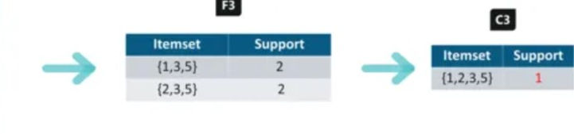
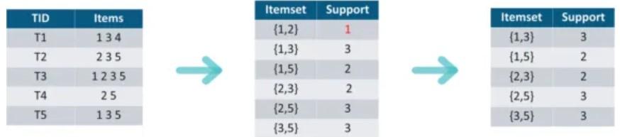
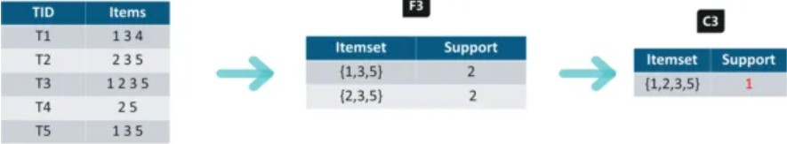
Let’s say we have the following transaction data of a store.
Pruning: Divide into subsets and eliminate.
Iteration 1: Let’s assume the min support value is 2.
Iteration 3: Creating item sets of size 3
Iteration 2: Next we will create item sets of size 2.
Iteration 4: Creating item sets of size 4

Slide 13
For I = {1,3,5}, subsets are {1,3}, {1,5}, {3,5}, {1}, {3}, {5}
minimum confidence = 60%
Applying Rules:
For every subsets S of I, you output the rule
S -> (I-S) (means S recommends I-S)
if support(I) / support(S) >= min confidence value
Set | Rule | Association | Confidence | Status
{1,3,5} | Rule 1 | {1,3} -> 1 & 3 -> 5 | 66.66% > 60% | Selected
{1,3,5} | Rule 2 | {1,5} -> 1 & 5 -> 3 | 100% > 60% | Selected
{1,3,5} | Rule 3 | {3,5} -> 3 & 5 -> 1 | 66.66% > 60% | Selected
{1,3,5} | Rule 4 | {1} -> 1 -> 3 & 5 | 66.66% > 60% | Selected
{1,3,5} | Rule 5 | {3} -> 3 -> 1 & 5 | 50% < 60% | Rejected
{1,3,5} | Rule 6 | {5} -> 5 -> 1 & 3 | 50% < 60% | Rejected

Slide 14
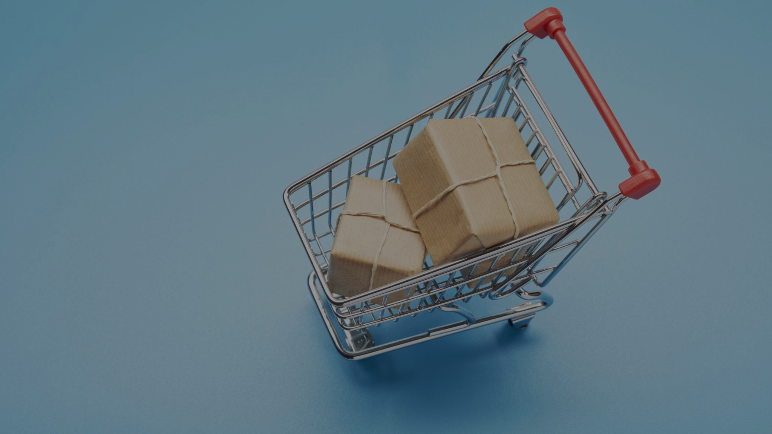
Real-world applications of Market Basket Analysis. Amazon: Amazon's recommendation system is a prime example. Netflix: Netflix uses MBA to suggest movies and TV shows. Retail: Supermarkets optimize product placements.​ ​

Slide 15
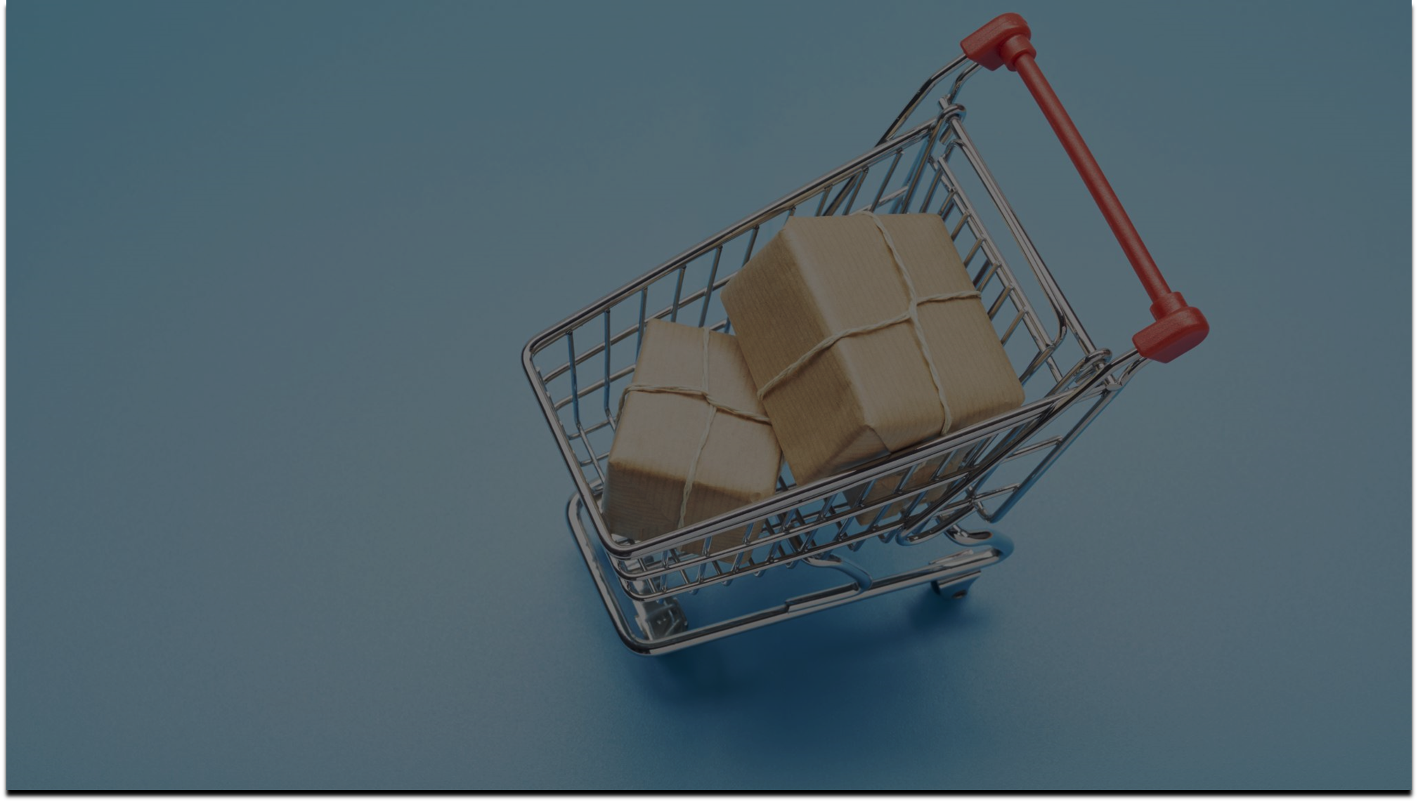
What are the limitations of Market Basket Analysis​? Performance Issues with large datasets.​ Overly Simplistic: Ignores external variables like seasonality.​ Risk of False Positives: Coincidental item associations.​

Slide 16
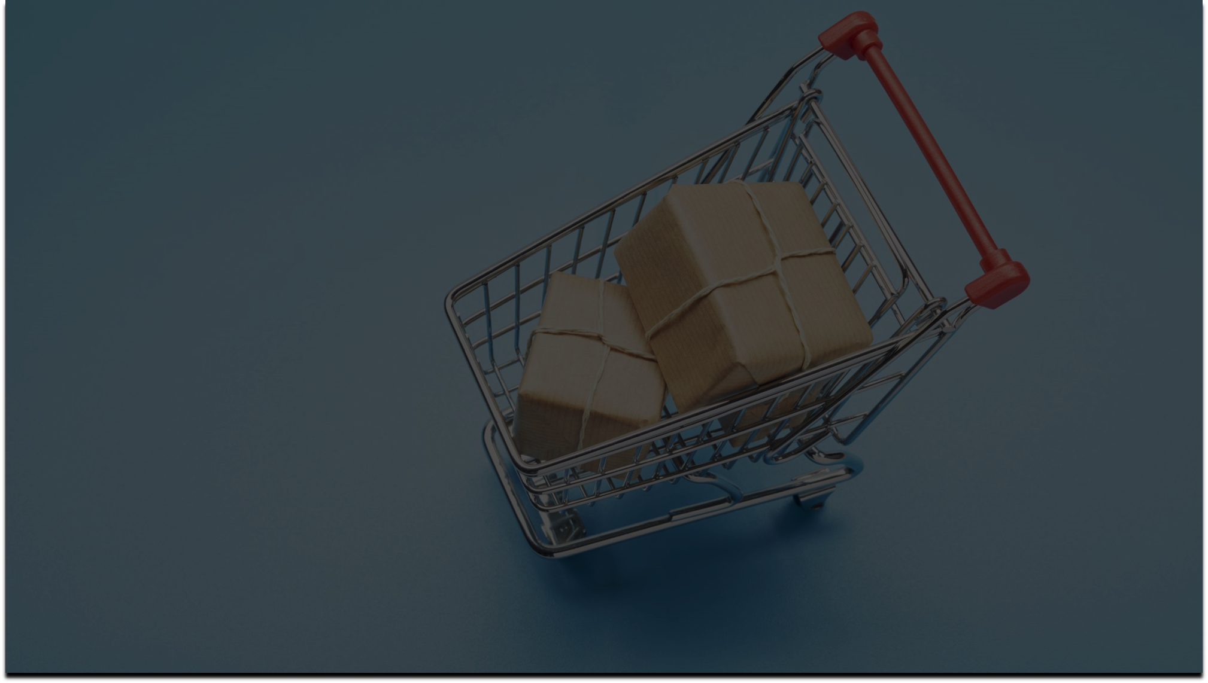
Key Take Away:​ Market Basket Analysis is a business strategy used to design store layouts based on customers’ shopping behavior and purchase histories.​ This idea is also applicable to machine learning algorithms to teach machines to help businesses, especially in the e-commerce sector.​ In this article, we have looked into the math behind the association rules​. Also, gone through an overview of the Apriori algorithm. ​ ​ ​

Slide 17

Thank You

